Slide 1
MATH
Machine Learning
LAB 4
Bharuno Mahesworo

Slide 2
How to LAB?
Download this PPT
Follow the instruction
Screen shoot your code and its result of each instruction, then put it on the instruction slide.
Submit your slide deck and notebook file
Googling is permitted
Using Communication platform (email, discord, social media, etc.) is prohibited
Submit to:
bharuno.mahesworo@binus.ac.id
Before the end of the LAB.
Subject: ML_(class code)_(LAB session)_NIM
Example: ML_LZ99_LAB1_12345
File name format: ML_(class code)_(LAB session)_NIM
Example: ML_LZ99_LAB1_12345

Slide 3
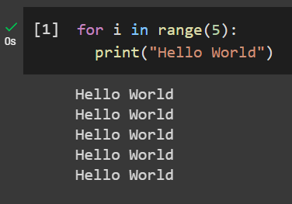
Print Hello World 5 times using loops
Example
Instruction
Your compiled codes
hint
for loops or while loops

Slide 4
LAB 4 – Ensemble Model Classification
The objective is to classify unbalanced dataset. “dataset_lab4.xlsx” can be downloaded from binusmaya
Target Variable
Target: 0 or 1

Slide 5
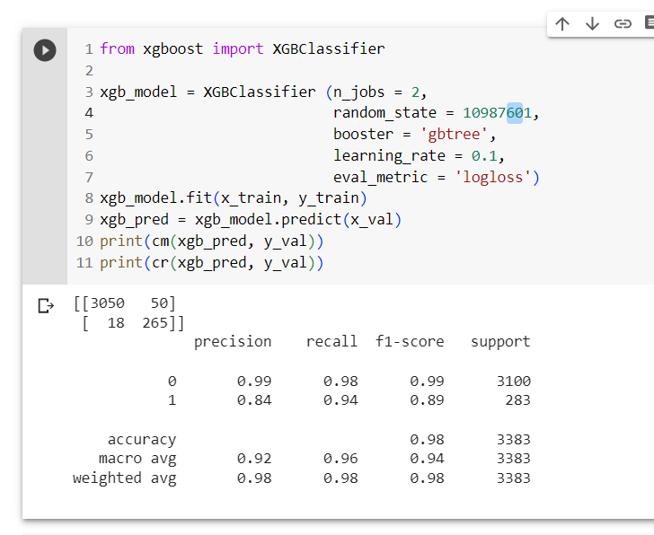
1. Make an ensemble model with the goal of getting the highest possible F1 score for the class – 1 target variable on validation performance!

